Slide 1
Evolution of 3D
Section B – Evolution of Digital Media
By Louisa and Mia

Slide 2
What is 3D?
3D TV and the human eye have a lot in common. Since our eyes are spaced apart, the left and right eyes see images from a slightly different perspective. Our brain then combines the two images to create a 3D impression. 3D TV works in the same way. Two images – each from a slightly different angle - are viewed through the 3D glasses and then combined by the brain to create a 3D image.

Slide 3
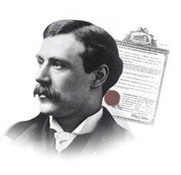
History of 3D
1890 - English filmmaker and inventor William Friese-Greene projected both left and right images on one screen and provided people with red and green glasses, resulting in a 3D effect when watching the film.
The first 3D film, The Power of Love, was released; red and green polarised films were viewed through red and green glasses to create the 3D effect.

Slide 4
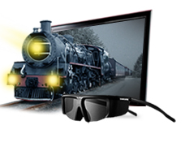
History of 3D
1970 - Film Director Allan Sollipant and Opticist Chris Condon created a new 3D technology called Stereovision. This new 3D method replaced the use of two separate films on two screens with a new 3D film that was projected onto a single screen.
2004 - The first IMAX 3D movie, The Polar Express, was released.

Slide 5
History of 3D
2010 - The release of Oscar-winning Avatar brought renewed interest to 3D television. 3D TVs using Shutter Glasses 3D technology launched in 2010.
2011 - Shutter glasses 3D technology was followed by FPR (Film Patterned Retarder) 3D technology, launched in 2011 FPR allows viewers to enjoy the 3D TV experience while wearing lightweight battery-free glasses.

Slide 6
Future of 3D
www.youtube.com/watch?v=bZVAM40kIMs
http://www.Reelz.com/trailer-clips/66302/the-future-of-3d-movies
I do not know the future

